Slide 1
Software Engineer at an SME

Slide 2
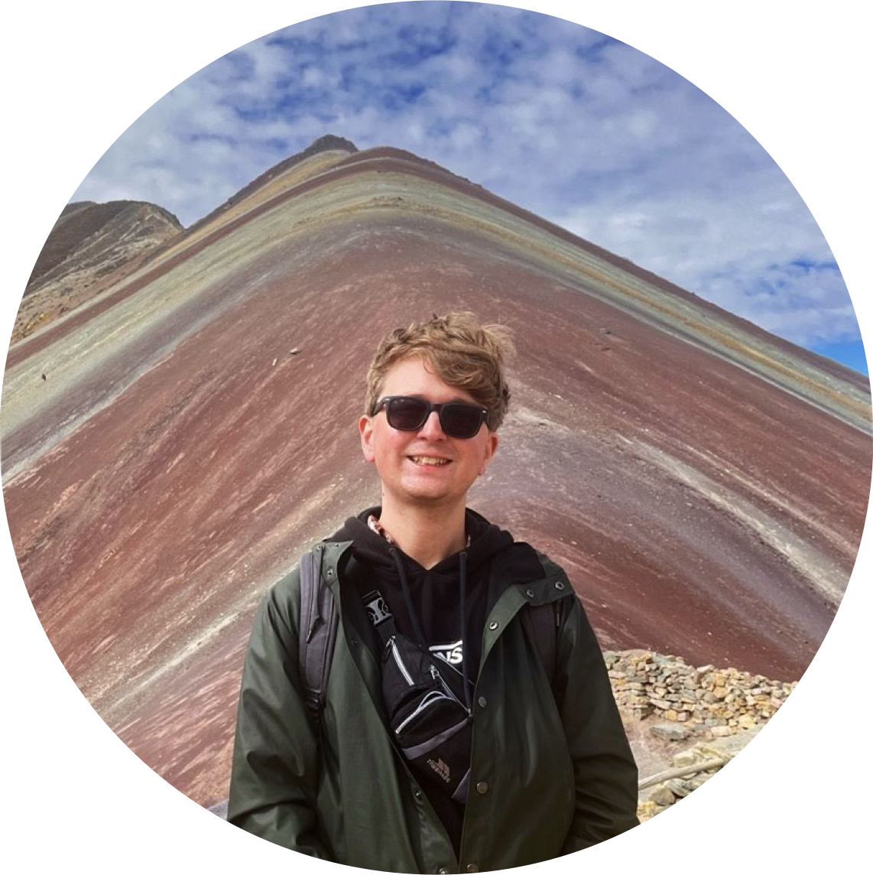

Introduction
Josh Porter
Senior Software Engineer
Search Team - Awaze

Slide 3
Journey to this point
University of Manchester
Inviqa
Booking.com
Awaze
Placement year @ Inviqa
Notes:
I am senior software engineer at Awaze.
Senior Software Engineer – Awaze
University of Manchester – BSc Internet Computing
Year in Industry – Inviqa
Software Engineer – Inviqa 3 years
Software Engineer – Booking.com 3 years
Software Engineer – Awaze 4 years
Senior Software Engineer - Awaze

Slide 4



Awaze
Awaze is the largest managed vacation rentals and holiday resorts business in Europe. Including travel brands: cottages.com, Hoseasons and NOVASOL.
Notes:
I am senior software engineer at Awaze.
Journey to this point:

Slide 5
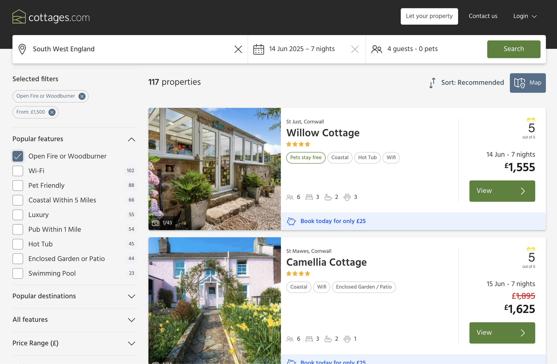
My role
Product Team - Search
Collaborate with team members to create and maintain the search platform at Awaze
Team
Engineering Manager
Product Manager
Business Analyst
Software Engineers (Junior, Senior)
Data Scientist
QA Engineer (Tester)

Slide 6





Tools
Programming Languages – Kotlin (Java Virtual Machine (JVM) based programming languages)
Database technology – Opensearch
Infrastructure technologies - AWS, Terraform
Tools – Github, Jetbrains IntelliJ (with Github Copilot)
Autonomy to pick the best tool for the job
Notes:
Enjoy working at an SME
Autonomy to choose tools
Booking.com was fixed into

Slide 7
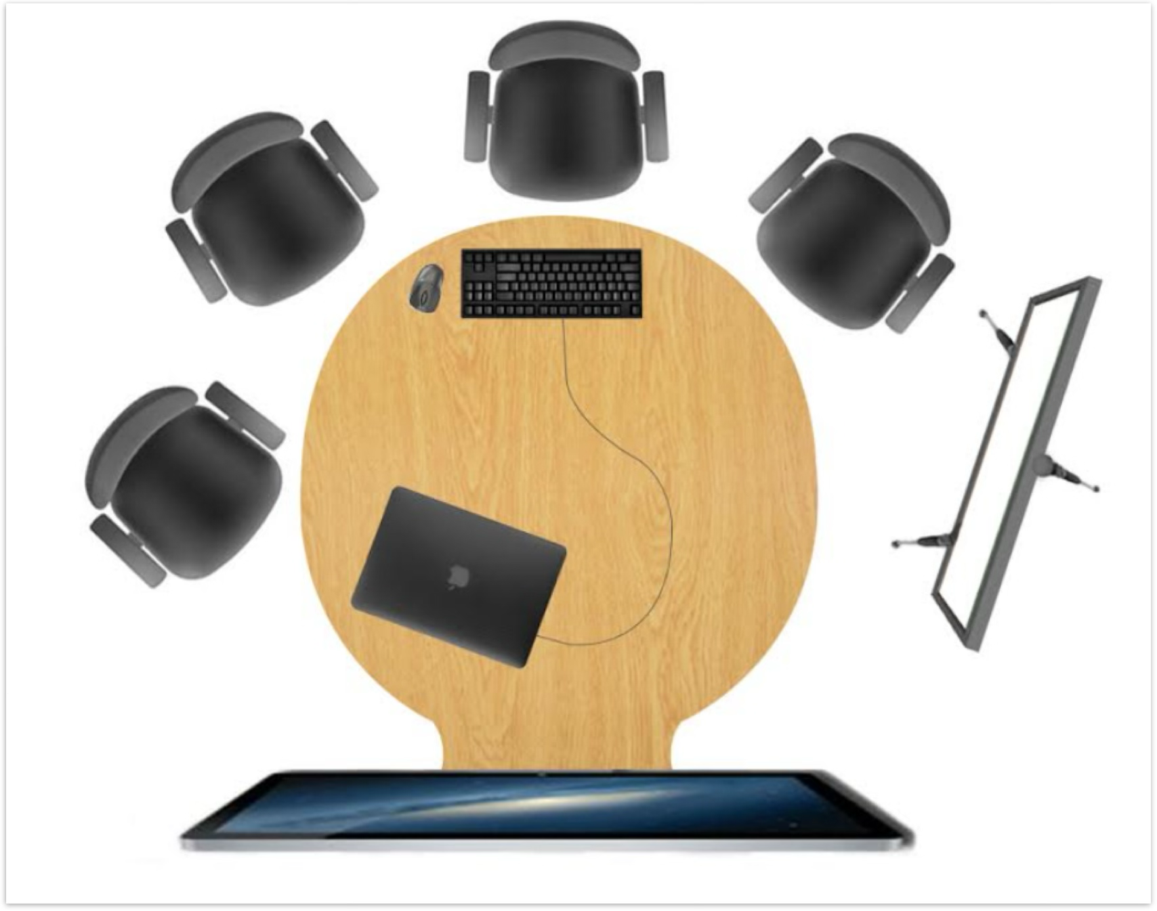
Collaboration as a Software Engineer
Use mob programming to build features for our search product
“Mob Programming is a software development approach where the whole team works on the same thing, at the same time, in the same space, and at the same computer.”
Where the team creates and delivers the features valued by the business
Morning Session 10am to 12pm
Afternoon Session 1pm to 4pm
Notes:
Teamwork
Collaboration

Slide 8


Mob Programming - Benefits
Faster problem solving
Improved code quality
Upskilling of new team members
Remove knowledge silos

Slide 9
Final thoughts
Work experience/Placement
Go to meetups – Meetup.com
LeedsJs
Leeds Mobile
Yorkshire DevOps
Github Student Developer Pack
‘System Design Primer’ resource

Slide 10


Thanks!

